Slide 1
2024 Bond Program
Construction Management Association of America
January 25, 2024
Jenny Nicewander, P.E. (I) Director
Office of Bond and Construction Management

Slide 2
Overview
Why do we need a Bond Program?
What is a Capital Bond Program?
Technical Criteria / Need Inventory
Bond Program Timeline
CBTF Program Funding Recommendations
Staff Recommendation
Next Steps
Questions

Slide 3
Why a Bond Program?
Provides the City with an additional revenue stream to take on larger projects that would impact regular maintenance and operations of City work.
Allows the City to fulfill Master Plans on a predictable and consistent timeframe.
Allows for major maintenance items without impacting general operations budgets.

Slide 4
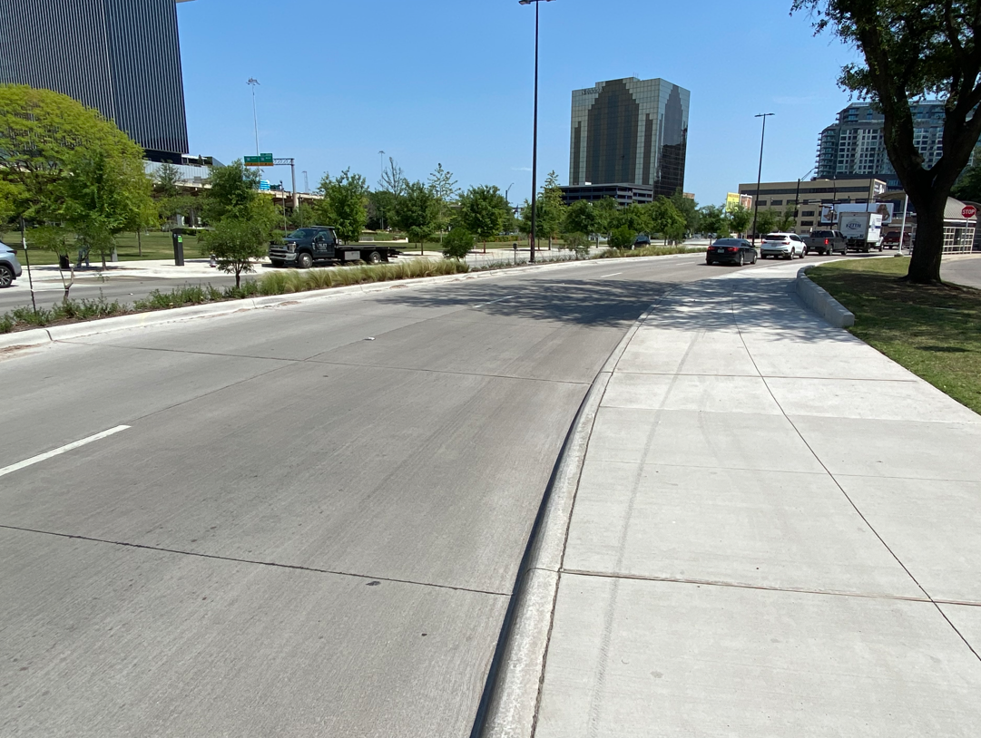
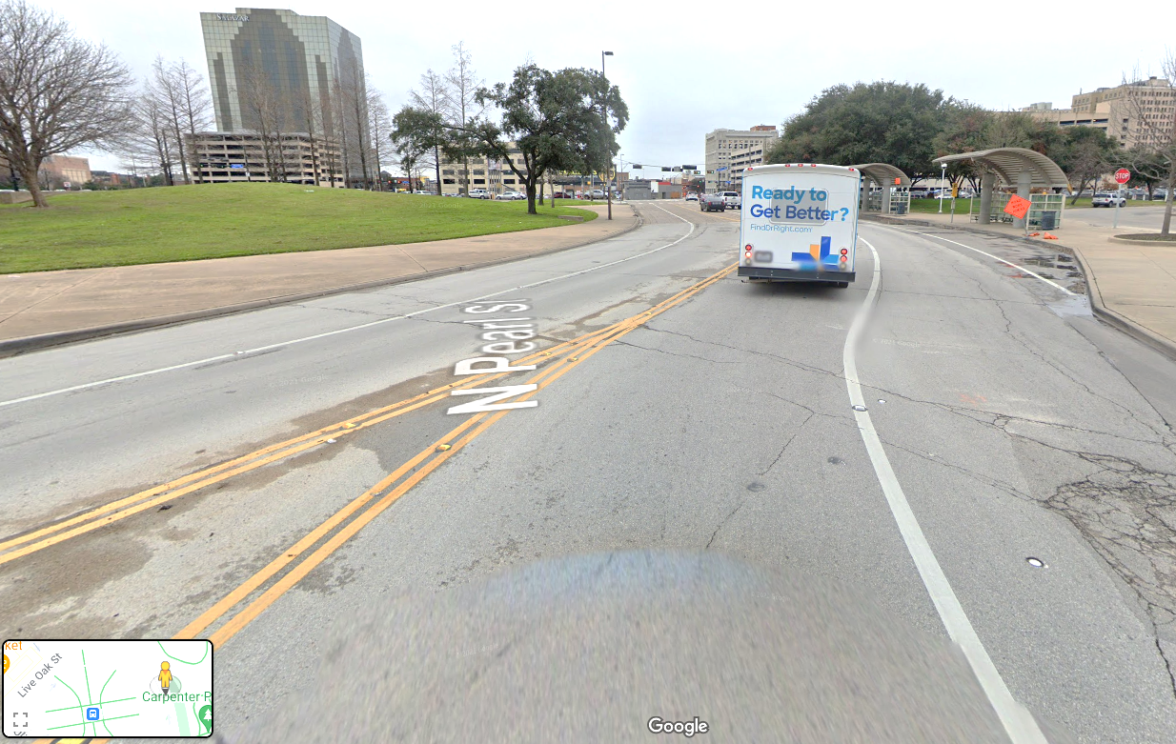
Why a Bond Program?
City relies on Bond dollars to fund the larger, more complex projects that are needed through out the City
Streets
Street Reconstruction - over $2M+ a lane mile

Slide 5
What is a Bond Program?
Bond Program is funded through voter issued debt.
General Obligation (GO) Bonds are sold and paid back with city taxes over a 20-year period.
Projects selected must be large enough to warrant GO bonds and have a service life of at least 20 years.
Capacity of Bond is limited by what City can borrow without increasing taxes to residents.

Slide 6
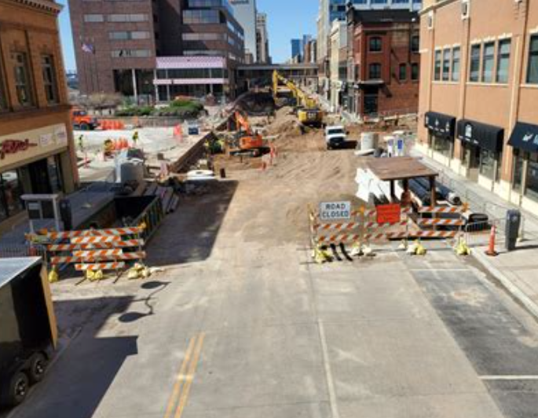
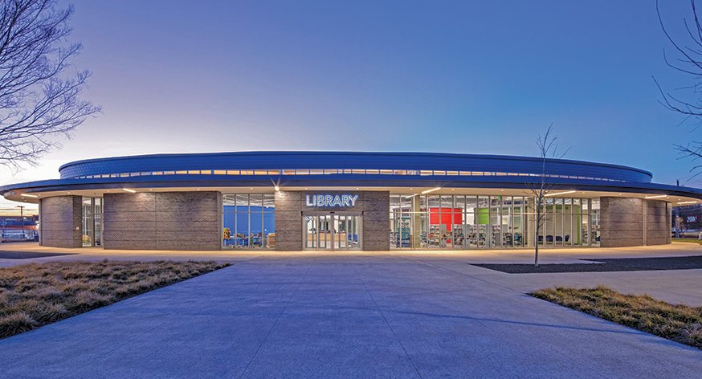
What is a Bond Program?
Types of Eligible Projects
Typical Bond Projects:
Street and Thoroughfare Improvements
Reconstruction or Resurfacing
Alley reconstruction
Sidewalk construction
Traffic Signals/Traffic Calming
Park and Recreation Facilities
Flood and Erosion Control Improvements
New or Replacement City Facilities
Rehabilitation of existing facilities
Economic Development Projects
Housing Infrastructure/Housing Projects

Slide 7
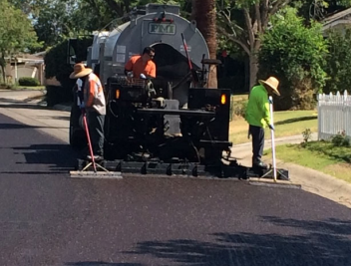
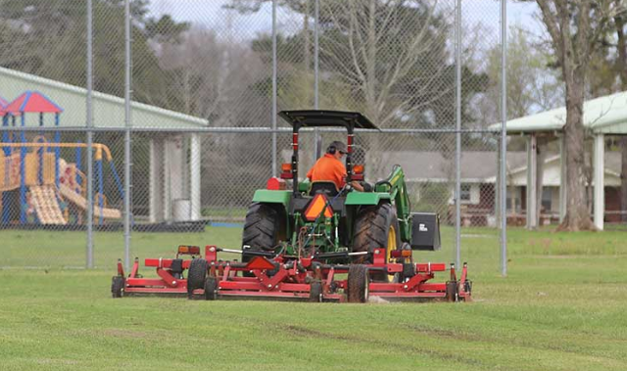
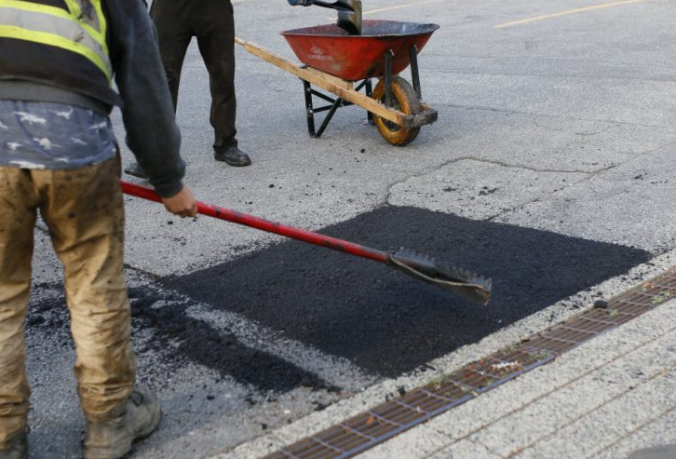
What is a Bond Program?
Types of work not included:
Routine operation and maintenance activities
Potholes
Minor street repairs
Landscaping maintenance
General Building Maintenance
Improvements for short term leased space
Code Enforcement Initiatives

Slide 8
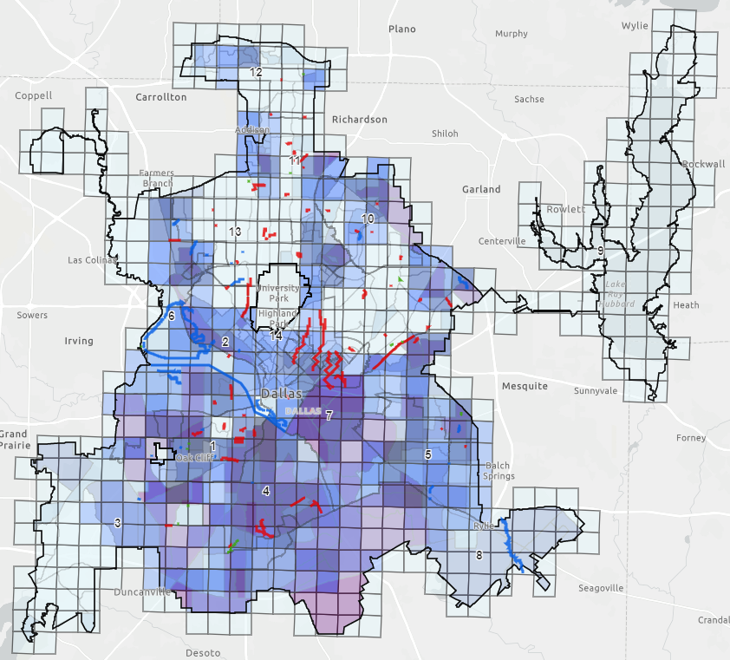
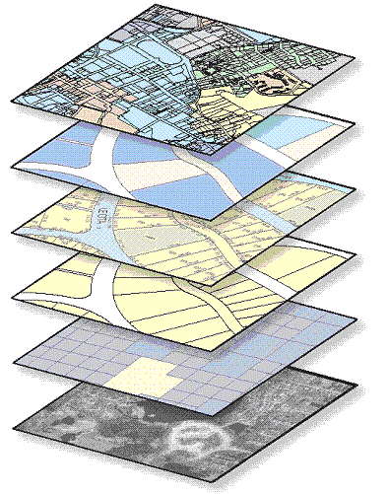
How are Projects Selected?
Needs Inventory (NI)
The City maintains an Infrastructure Needs Inventory list.
The NI includes costs for future capital projects based upon condition, maintenance records, master plans, residents input, and City Council recommendations.
The ranking and prioritization of projects is conducted through a Technical Criteria Process developed by designated subject matter experts in each infrastructure department as well as taking into consideration City policy and/or initiatives.
Once the City's Needs Inventory is ranked and prioritized, a recommended list of capital projects is vetted through the City's various committees before finalizing.
Notes:
So how are projects selected?
The City maintains what is called an Infrastructure Needs Inventory list.
This list is a comprehensive list that includes costs for future capital projects based upon condition, maintenance records, master plans, resident input, and City Council recommendations.
The ranking and prioritization of projects is conducted through a technical criteria process developed by designated subject matter experts in each infrastructure department as well as taking into consideration City policy and/or initiatives. That may include the City’s Housing Policy, Strategic Mobility Plan, etc.
Once the Needs Inventory is ranked and prioritized a recommended list of capital project is vetted through the City’s various committees before finalizing.

Slide 9
Needs Inventory
Proposition | Needs Inventory | Percentage of the Total
Streets & Transportation | $8,617,243,301 | 50.33%
Park & Recreation | $3,183,468,143 | 18.59%
Flood Protection, Storm Drainage and Erosion Control | $2,528,460,500 | 14.77%
Housing Infrastructure | $400,000,000 | 2.34%
Economic Development | $100,000,000 | 0.58%
Public Safety Facilities (PSF) - Combined | $1,200,167,403 | 7.01%
Cultural and Performing Arts Facilities | $166,826,869 | 0.97%
City Facilities | $649,756,540 | 3.79%
Library Facilities | $106,668,601 | 0.62%
Homeless Assistance Facilities | $35,000,000 | 0.20%
Information Technology | $135,000,000 | 0.79%
Totals | $17,122,591,356 | 100.00%
* Housing, Economic Development and Information Technology amounts are based on previous presentations.

Slide 10
Bond Program Timeline
Spring 2023
Townhalls, CBTF Meetings, and Technical Criteria Briefings began
Summer 2023
Public input began at CBTF meetings (227 speakers)
Fall 2023
Subcommittees of CBTF develop Bond recommendations
December 2023
CBTF & Staff present bond recommendations
January 2024
Council advised staff to work towards a $1.25B Bond program and a May election.
February 2024
Allocation levels will be determined, bond program finalized, and Council will call for an election on February 14.
March/April 2024
Project selection to be finalized. Informational townhalls and materials to be developed,
April 22-30 2024
Early Voting
May 4, 2024
Bond Election

Slide 11
Bond Program Timeline and Next Steps
For a May 2024 Bond Election:
January 19th: Council approved a May Election and an overall capacity of $1.25B.
January 31st: City Council Briefing, per the Mayor’s Memorandum sent on December 29, 2023;
Staff to present proposed bond projects by proposition
February 7th: City Council Briefing – Discuss and finalize project listing
February 14th: City Council calls for a May election

Slide 12
Next Steps
December/January – work with Council to refine bond program.
January/February – Briefing(s) and City Council to call for a May Election.
Last day to call for an election February 14, 2024.*
Once Council call for an election, PBW and BCM will be
February through May – Mayor and Council lead advocacy efforts to promote the 2024 bond program.

Slide 13
Next Steps
For a May 2024 Bond Election (continued):
March: Staff to finalize facts and information materials that include project listing
April: Townhall informational meetings
April 22 – 30: Early Voting
May 4th: Election Day

Slide 14
Questions
Questions?

Slide 15
2024 Bond Program
Construction Management Association of America
January 25, 2024
Jenny Nicewander, P.E. (I) Director
Office of Bond and Construction Management

